Slide 1
IE 412: Industrial Facilities Design
Prerequisites: Work Study and Methods Engineering, Production Planning and Control
Objective:
To enable the students to understand facility planning, Material handling equipment analysis, warehousing, layout and location and flow of material, Exposure to relevant computer software.
Contents:
Location and Site selection, Facility design stages, processes, material handling equipment and analysis, Area allocation and space requirements, Flow analysis, fabrication of individual parts, total plant flow, Plant layout, Utilities Layout, Computerized facility layout and location, Strategies for storages.
Recommended Books:
1. Facilities Planning by Tompkins & White, John Wiley
2. Manufacturing Facilities: Location, Planning & Design by D. Sule, P.W.S.-Kent Publishing Company

Slide 2
Objectives of Facility Planning
The facilities planned today must help an organization achieve Supply Chain Excellence.. It has six steps/levels;
Business As Usual (buy-make-move-store-sell)
Link Excellence
Visibility
Collaboration
Synthesis

Slide 3
Facilities’ Characteristics
All the facilities in the supply chain should have the following characteristics:
Flexibility
Modularity
Upgradability
Adaptability
Selective Operability

Slide 4
Definitions
Facilities Planning determines how an activity’s tangible, fixed assets should contribute to meeting the activity’s objectives .
The facility planning comprises of two components
Facility Location
Facility Design

Slide 5
Definitions
Facility location refers to;
The placement w.r.t. supplier and customer and other facilities with which it interacts.
Also placement and orientation on a specific plot of land
Facility Design consists of ;
Facilities Systems
Facilities layout (plant layout)
Handling System

Slide 6
Facility System
Facility system consist of the;
structural system,
atmospheric system,
enclosure system,
lighting/electrical/communication and ventilation system,
safety system,
sanitations system

Slide 7
Facility Layout
Plant layout refers to the arrangement of physical facilities such as machinery, equipment, furniture etc. within the factory building in such a manner so as to have quickest flow of material and information
The Handling system consists of the mechanisms needed to satisfy the required facility interactions.

Slide 8
Facilities planning
Facilities location
Facilities planning
Facilities System design
Facilities design
Layout design
Handling System design

Slide 9
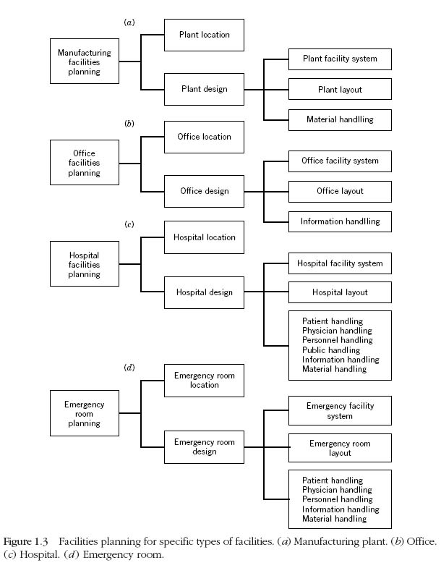
f01_02
Notes:
f01_02.jpg

Slide 10
Facility Planning Viewpoints
Facilities planning is complex and broad subject cuts across several disciplines
Civil engineering
Electrical
Mechanical engineering
Architectural
Real estate
Urban planning
Industrial engineering
However, here we’ll focus on industrial engineer’s role in developing effective and efficient facilities plans.

Slide 11
IE Viewpoint of Facilities Planning
IEs are focusing on requirements, resource allocation, and efficient use of resources.
Facilities are the integration of many lower level systems
Space requirements with respect to flow and operations control
Personnel requirements
Equipment requirements
System design/layout with respect to flow and operations control
The use of information systems and technology to increase effectiveness
Movement within a facility
Movement between facilities – Location
…

Slide 12
Why matters?
To stimulate your thought, think of the following questions:
What impact does facilities planning have on handling and maintenance costs?
What impact does facilities planning have on employee moral?
What impact does facilities planning have on management of a facility?
What impact does facilities planning have on a facility’s capability to adapt to change and satisfy future requirements?

Slide 13
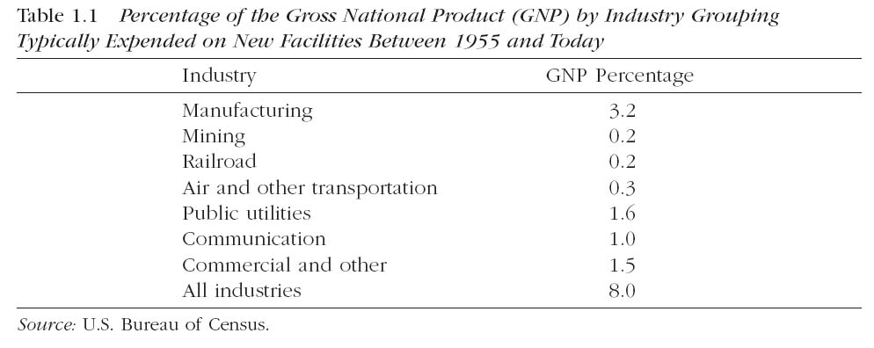
Why matters?

Slide 14
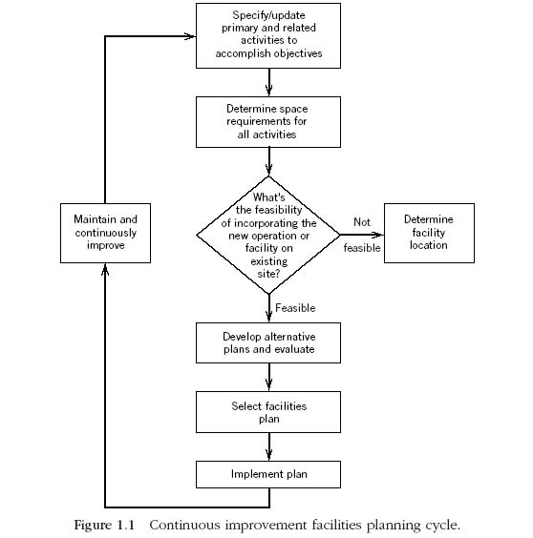

Slide 15
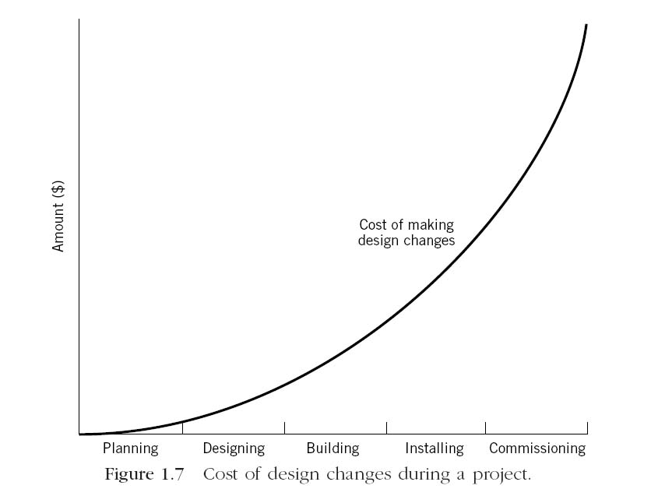
f01_07
Why matters?
Notes:
f01_07.jpg

Slide 16
Facility Planning Process
Define the problem
Define the objective of the facility
Specify the primary and support activities to accomplish objectives
Analyze the problem
Determine the interrelationship among all activities
Determine the space requirements for all activities
Generate alternative facility plans
Evaluate the alternatives
Select the Preferred design
Implement The design
Maintain and adopt the facility design
Redefine the objectives of the facility

Slide 17
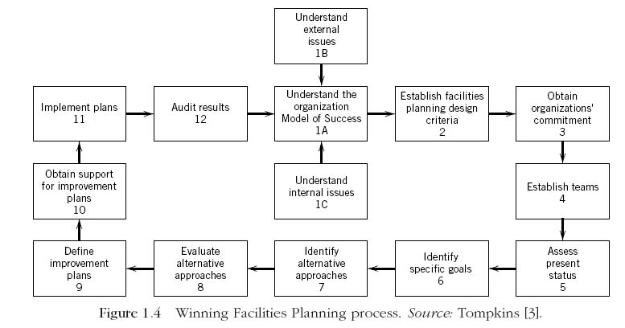
f01_04
Notes:
f01_04.jpg

Slide 18
Data for Strategic Facility Design
What is to be produced?
How are the products to be produced?
When are the products to be produced?
How much of the product is to be produced?
How long will the product be produced?
Where are the products to be produced?

Slide 19
Issues Impacting a Strategic Facilities Plan
Number, location, sizes of warehouse/distribution centers
Centralized vs. decentralized storage / manufacturing
Acquire existing (brownfield) vs. build new (greenfield)
Flexibility required for marketing & technology
Interfacing storage and manufacturing
Level of vertical integration
Control of materials and equipment
Inbound and outbound material movement
Technology changes for suppliers, firm, customers
Financial goals for the design of the facility

Slide 20
Week wise | Tentative Course Contents
1 | Facility Planning Introduction
2 | Product, Process, and Schedule Design
3 | Flow, Space, and Activity Relationships
4 | Flow, Space and Activity/Personal Requirements
5 | Problems/ Discussion/Review
6 | Material Handling
7 | Material Handling
8 | Review Period/Mid Term Exam
9 | Layout Planning Models
10 | Layout Planning Models/Warehouse Operations
11 | Manufacturing Systems
12 | Facilities Systems
13 | Quantitative Facilities Planning Models
14 | Problems/ Discussion/Review
15 | Evaluating, Selecting, and Implementing the Facilities Plan
16 | Evaluating, Selecting, and Implementing the Facilities Plan

Slide 21
Marks Distribution
Mid Term Examination | 20
Home works/Assignments | 08
Quiz | 12
Lab Work | 20
Final Exam | 40
Total marks | 100

